Slide 1
Chapter XVIII
Surface Tessellation

Slide 2
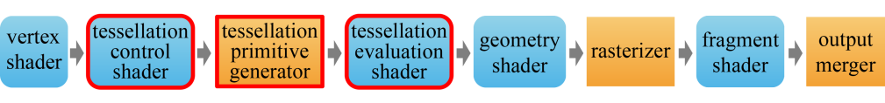
Hardware Tessellation
  The most notable feature of OpenGL ES 3.2 is the support for hardware tessellation. It enables the GPU to decompose a primitive into a large number of smaller ones.
  GPU tessellation involves two new programmable stages, the tessellation control shader (henceforth, simply control shader) and the tessellation evaluation shader (henceforth, evaluation shader), and a new hard-wired stage, the tessellation primitive generator (henceforth, tessellator).
18-<number>

Slide 3
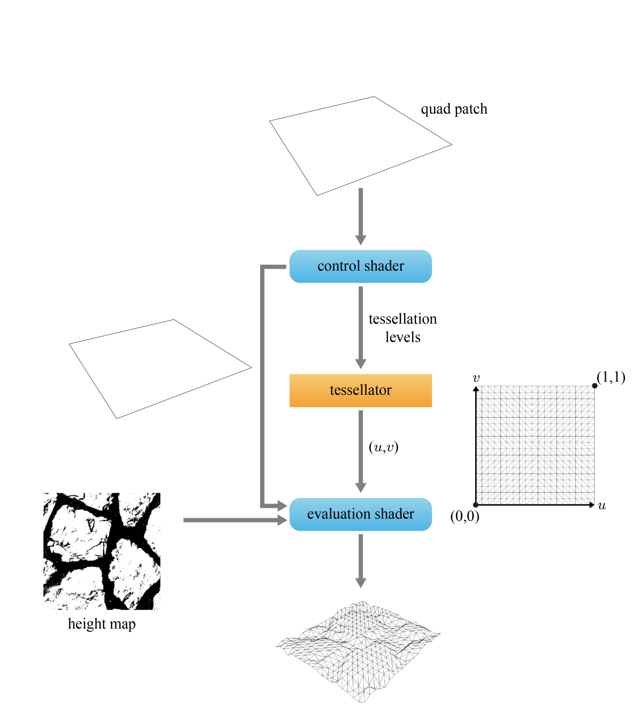
Displacement Mapping
  The input is called a patch. It is either a triangle or a quad.
  For the paved-ground example, the control shader takes a quad as the base surface and passes it, as is, to the evaluation shader.
  The control shader determines the tessellation levels and passes them to the tessellator, which accordingly tessellates the domain of the quad into a 2D triangle mesh.
  Running once for each vertex of the 2D mesh, the evaluation shader takes the quad as a bilinear patch, evaluates a point using (u,v), and displaces it using the height map.
18-<number>

Slide 4
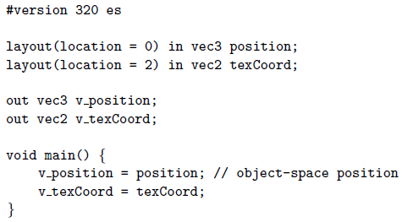
Displacement Mapping (cont’d)
  Vertex shader
  Observe that the vertex shader is exempt from the duty of computing gl_Position, the clip-space vertex position. It will be done by the evaluation shader.
18-<number>

Slide 5
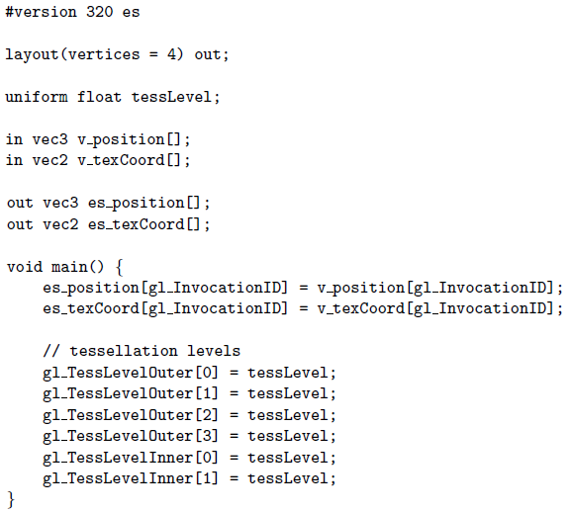
Displacement Mapping (cont’d)
  Multiple control shaders work in parallel, and an invocation of the control shader outputs the variables “of a vertex” in the patch.
  The number of output vertices is specified using the keyword, vertices.
  An invocation of the control shader rocesses a vertex, and the vertex ID is stored in the built-in variable gl_InvocationID.
18-<number>

Slide 6
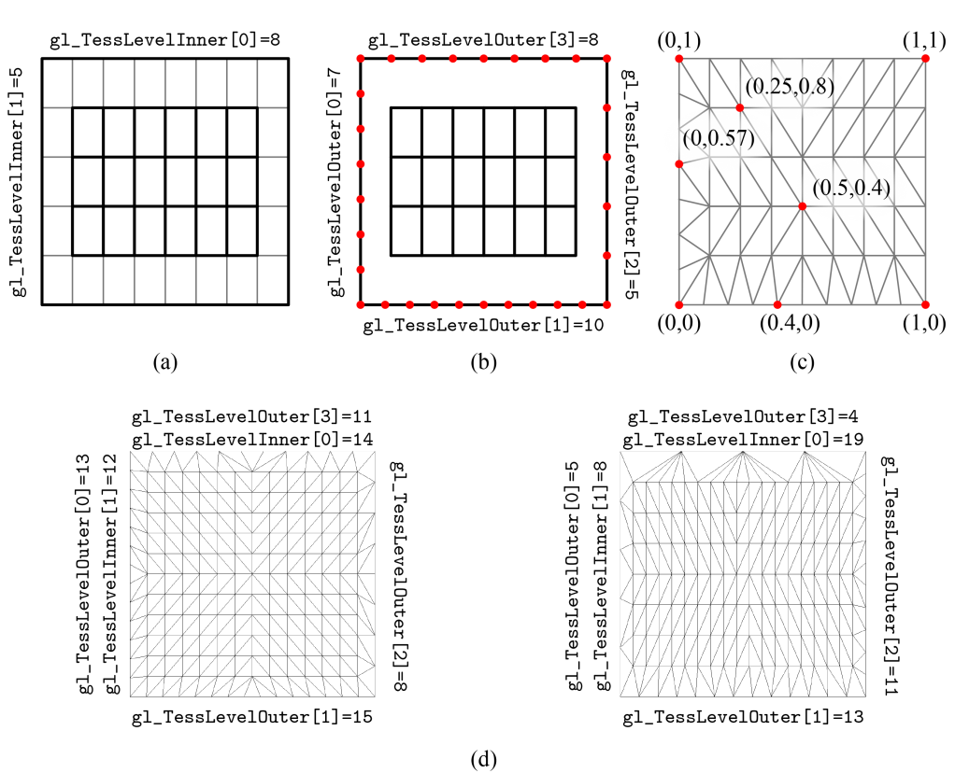
Displacement Mapping (cont’d)
  Tessellation levels
18-<number>

Slide 7
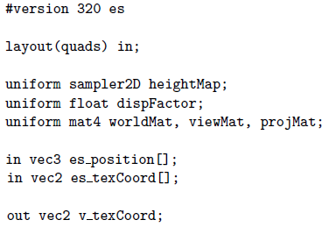
Displacement Mapping (cont’d)
  Evaluation shader
18-<number>

Slide 8
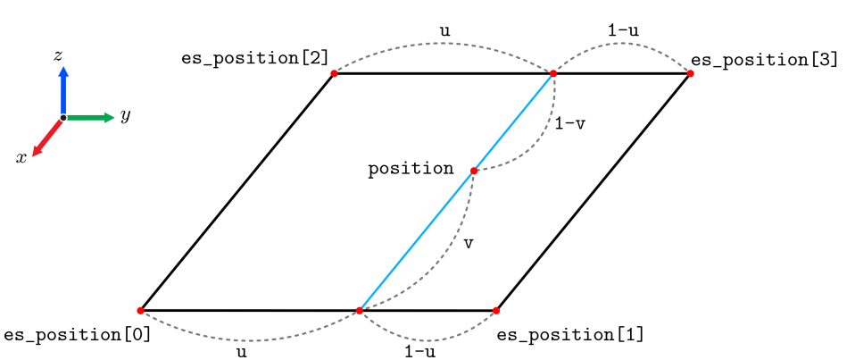
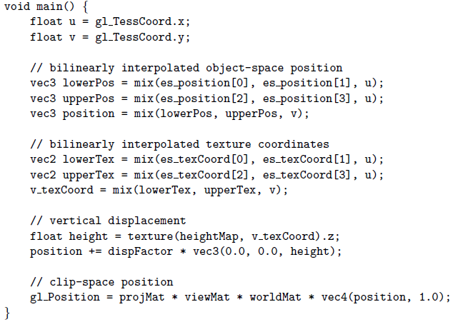
Displacement Mapping (cont’d)
  Evaluation shader
18-<number>

Slide 9
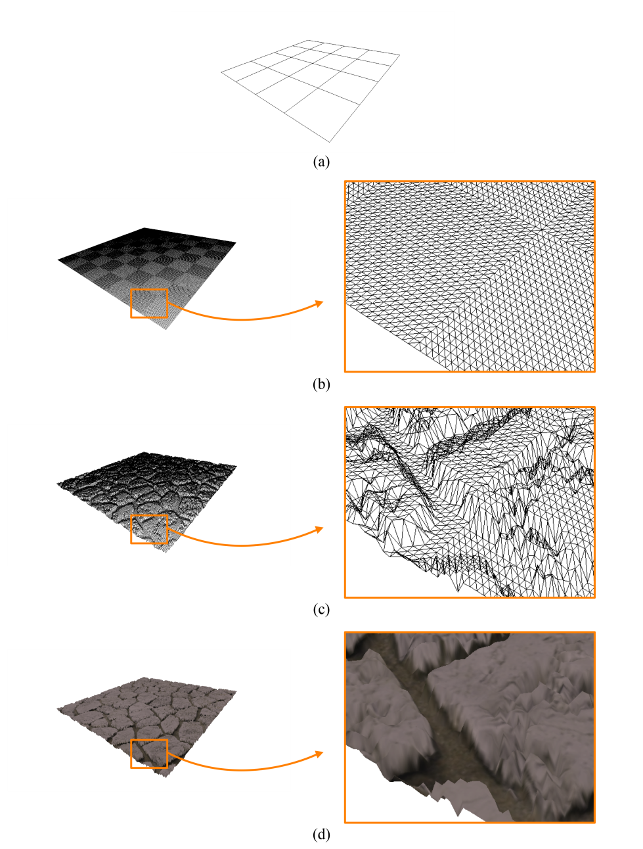
Displacement Mapping (cont’d)
  Example (16 quads)
18-<number>

